Slide 1
Lesson objective
Test tomorrow
Title: Topic revision
Aim – be able to:
Solve linear equations with brackets and variables on both sides
Substitute into linear functions to complete a table of values
Plan:
Solving equations
Table of values
Need calculators

Slide 2
Solving one step equations:
What you do to one side you do to the other.
Equation solving steps:
Simplify both sides
Collect variable terms to left and numbers to right – swap sides swap signs.
Simplify both sides
Divide both sides by coefficient.
Simplify both sides
Substitute back into original question to verify
$$x+2=5$$
$$5x=12$$
$$−2x=12$$
$$x−6=11$$
$$\frac{x}{2}=9$$

Slide 3
Your Turn
Solving one step equations:
What you do to one side you do to the other.
Equation solving steps:
Simplify both sides
Collect variable terms to left and numbers to right – swap sides swap signs.
Simplify both sides
Divide both sides by coefficient.
Simplify both sides
Substitute back into original question to verify
$$x+4=9$$
$$x−7=15$$
$$−6x=24$$
$$4x=20$$
$$\frac{x}{3}=2$$

Slide 4
Solving two step equations:
What you do to one side you do to the other.
Equation solving steps:
Simplify both sides
Collect variable terms to left and numbers to right – swap sides swap signs.
Simplify both sides
Divide both sides by coefficient.
Simplify both sides
Substitute back into original question to verify
$$3x+2=9$$
$$2x−8=13$$
$$5−x=−1$$
$$3x+(−2)=10$$

Slide 5
Your Turn
Solving two step equations:
What you do to one side you do to the other.
$$5x+6=30$$
$$4x−3=12$$
Equation solving steps:
Simplify both sides
Collect variable terms to left and numbers to right – swap sides swap signs.
Simplify both sides
Divide both sides by coefficient.
Simplify both sides
Substitute back into original question to verify
$$5−3x=−3$$
$$3x+(−4)=10$$

Slide 6
2x + 4 = 3x - 2
Collect the x’s together, it is better to try and keep the x values positive.
Collect the numbers together on the other side of the equals.
4x + 2 = 10x – 16
2x + 8 = 10 + 3x

Slide 7
Practice (1)
Exercise books
When the going gets tough, the tough get going…
1
7x + 2 = 3x + 14
x = 3
2
5x + 1 = x + 9
x = 2
3
7x + 5 = 4(x + 5)
x = 5
4
3x + 2 = x + 10
x = 4
5
5x + 1 = 3x + 13
x = 6
Show your working out!
Make your method clear, and remember that marks are still up for grabs if the answer is wrong!
Click an equation to see the solution, or
show all

Slide 8
Example
Simplify both sides
Collect variable terms to left and numbers to right – swap sides swap signs.
Simplify both sides
Divide both sides by coefficient.
State answer
4(y + 7) = 6y
5(2x +2) = 3(x – 4)
Expanding the brackets is simplifying.

Slide 9
Exercise books
2(x + 8) = 22
3(x – 2) = 6x – 21
-2(2x + 4) = 4
4(f + 4) = 3(3f – 4) – 2

Slide 10
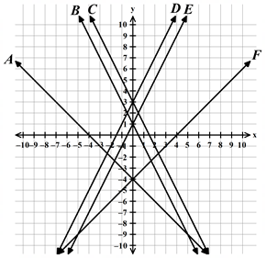

Rules
I do:
Rule for A
Rule for F
We do:
Rule for C
Rule for D
You do:
Rule for E
Rule for B
$$y=mx+c$$

Slide 11
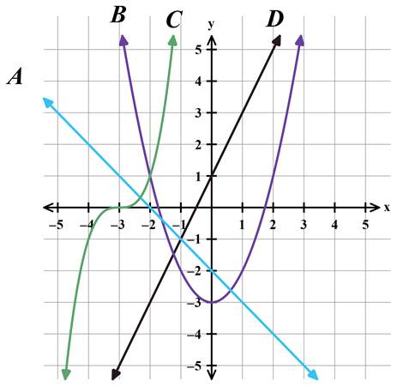
Linear means straight line
Linear functions are those whose graph is a straight line.

Slide 12
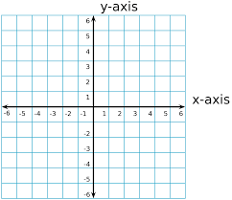
LINE GRAPHS
Plot the following graphs:
y = x + 3
y = 2x + 4
y = 3x – 2
y = 9 – x
Sketch table on your whiteboards.
x | 0 | 1 | 2
y
x | 2 | 4 | 6
y

Slide 13
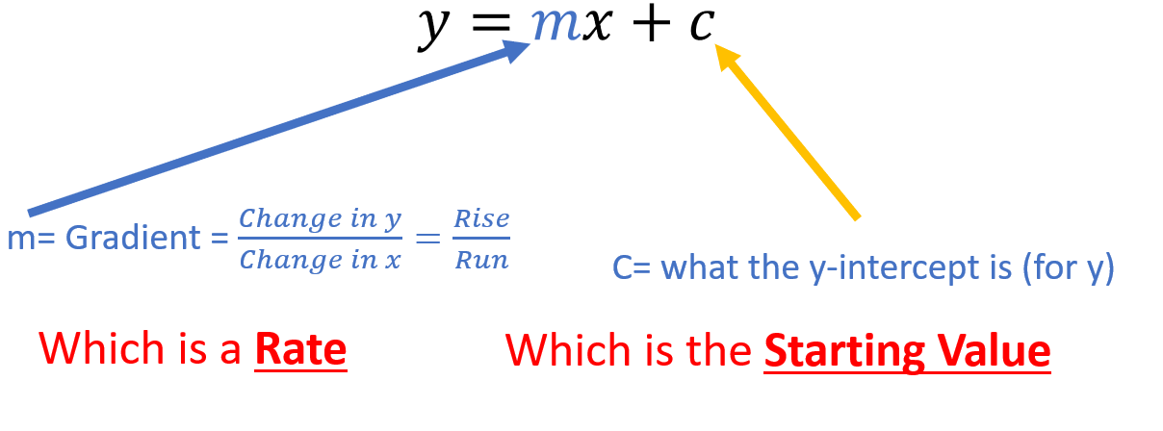

Slide 14
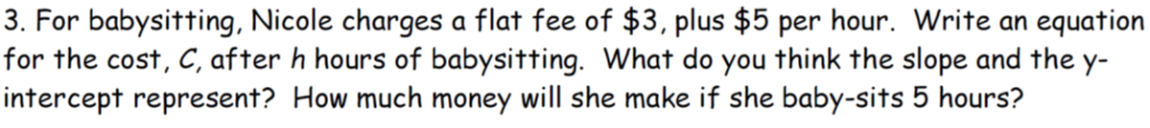
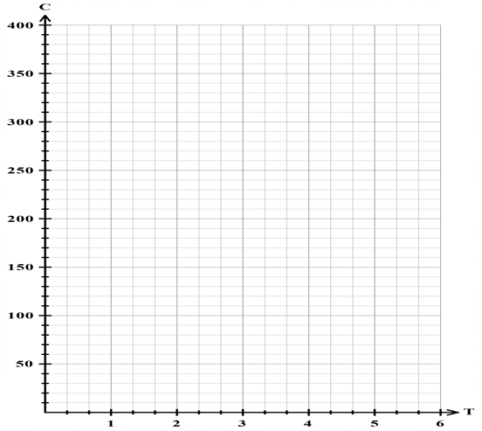
Graphing
Make the rule (use letters in context)
Make a table of values, starting at zero
Plot these as coordinates
Draw the line (connect the dots)
Time in hours (T) | 0 | 1 | 2 | 3
Cost (C)

Slide 15

We do
Make the rule (use letters in context)
Make a table of values, starting at zero
Plot these as coordinates
Draw the line (connect the dots)
Time (H) | 0 | 1 | 2 | 3
Cost (C)

Slide 16
We do
A water tank contains 350L. Each day it leaks 35L, how long until the tank is empty?
Make the rule (use letters in context)
Make a table of values, starting at zero
Plot these as coordinates
Draw the line (connect the dots)
Time (H) | 0 | 1 | 2 | 3
Cost (C)

Slide 17
Notes page
Equation solving steps:
Simplify both sides
Collect variable terms to left and numbers to right – swap sides swap signs.
Simplify both sides
Divide both sides by coefficient.
Simplify both sides
Substitute back into original question to verify
Linear functions are those whose graph is a straight line.
Make the rule (use letters in context)
Make a table of values, starting at zero
Plot these as coordinates
Draw the line (connect the dots)

Slide 18
Notes

